Slide 1

Police, Crime, Sentencing and Courts Act 2022
Christopher Pix

Slide 2
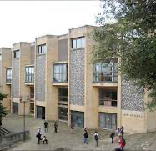

s28
Extension of s28 being rolled out across the Western Circuit
Pre-recorded cross-examination
All complainants in sexual offences and modern slavery
Identify early

Slide 3


Time limit to s39 CJA
Extending the prosecution time limit for domestic abuse-related common assault and battery charges
From 6 months of the offence to 6 months of it being formally reported to the police, up to a maximum of 2 years

Slide 4
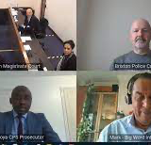
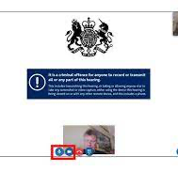
Use of CVP s51 CJA
New rules to end the need for participants to travel to court unnecessarily
Maximising the use of video and audio technology

Slide 5

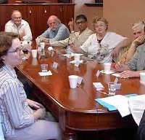
BSL interpreters for deaf jurors
BSL interpreter to sit on juries
Allowed in deliberation room with jury
Strict rules apply for the interpreter!

