Slide 1
New Offences
Olivia McGonigle (pupil)
July 2022

Slide 2
New offences
Causing serious injury by careless, or inconsiderate, driving
Non-fatal strangulation
Breastfeeding voyeurism

Slide 3
Causing serious injury by careless, or inconsiderate, driving
Created by s.87 of the Police, Crime,
Sentencing and Courts Act 2022: inserts s.2C
Causing serious injury by careless, or
inconsiderate, driving into the Road Traffic Act
1988.

Slide 4
Causing serious injury by careless, or inconsiderate, driving
History
Beginning of 2022: RTA 1988
s.1 – Causing Death by Dangerous Driving
s.1A – Causing Serious Injury by Dangerous Driving
s.2 – Dangerous Driving
s.2B – Causing Death by Careless Driving
s.2C – Causing Serious Injury by Careless, or Inconsiderate, Driving
s.3 – Careless, and Inconsiderate, Driving
s.3ZD – Causing Serious Injury by Driving: Disqualified Drivers
Necessity
Recognise the harm where drivers cause injury
Close the gap in the law relating to serious injury: “as no current offence adequately punishes the serious and potentially life changing injuries that can result from careless driving”

Slide 5
Causing serious injury by careless, or inconsiderate, driving
Legislation

Slide 6
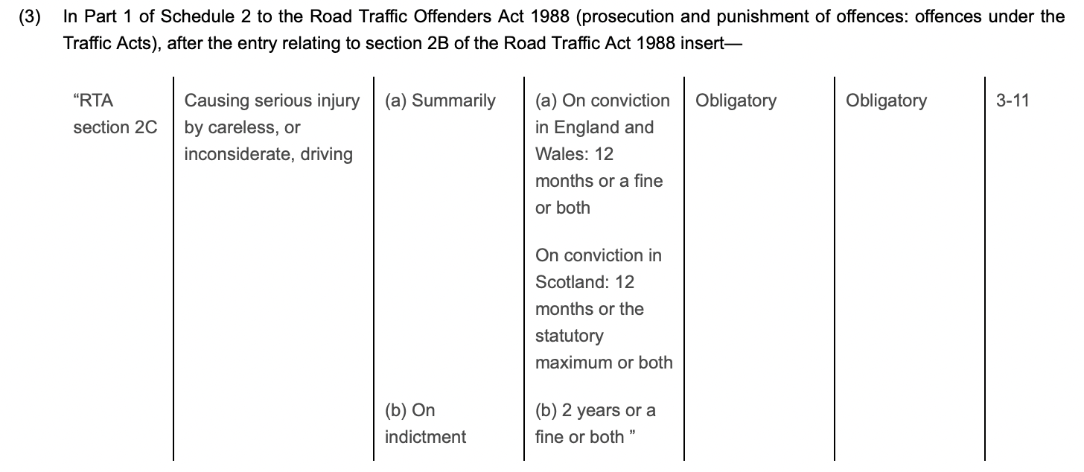
Causing injury by careless, or inconsiderate, driving
Text

Slide 7
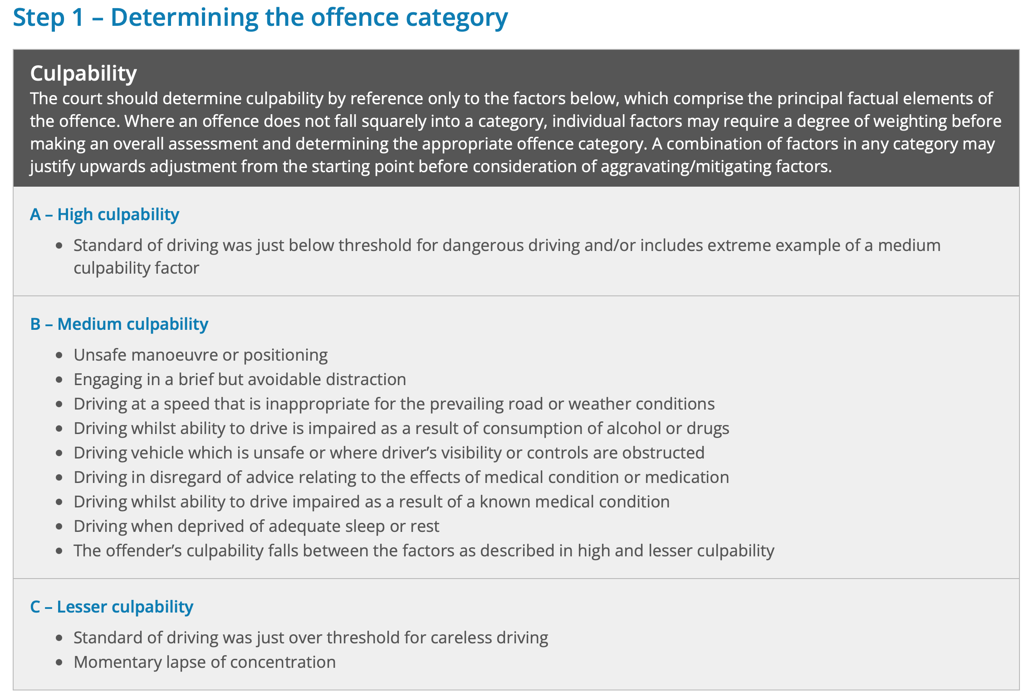
Causing injury by careless, or inconsiderate, driving

Slide 8
Causing injury by careless, or inconsiderate, driving

Slide 9
Causing injury by careless, or inconsiderate, driving

Slide 10
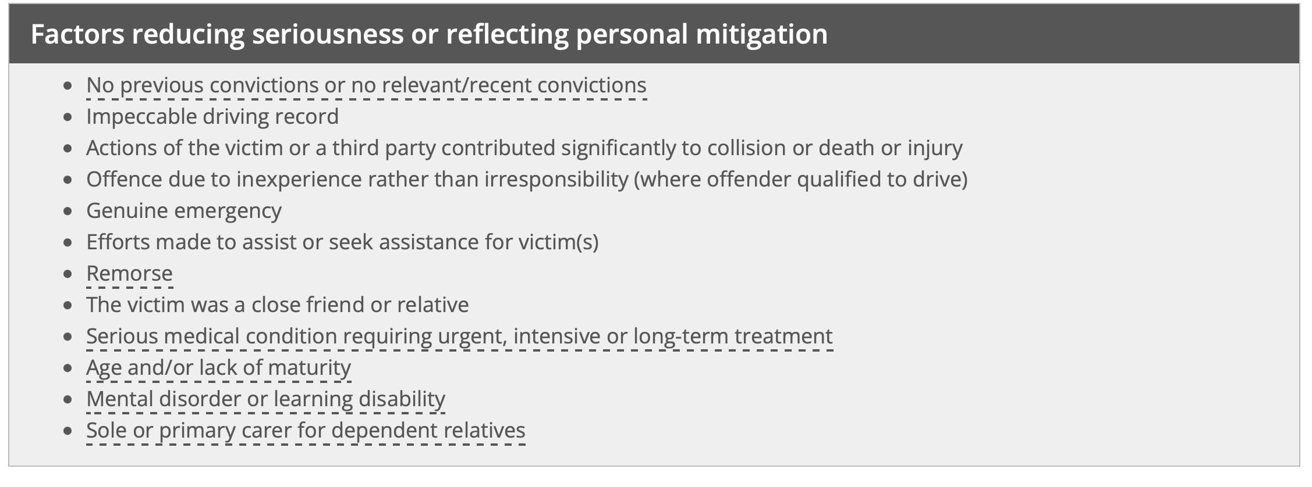
Causing injury by careless, or inconsiderate, driving
Text

Slide 11
Causing injury by careless, or inconsiderate, driving
Effect
Defendants
Increased number of trials – (more) delays in the CJS
Police investigations

Slide 12
Non-fatal strangulation or suffocation
Created by s.70 of the Domestic Abuse Act
2021: inserts s.75A Strangulation or suffocation into the Serious Crime Act 2015.

Slide 13
Non-fatal strangulation or suffocation
s.75A

Slide 14
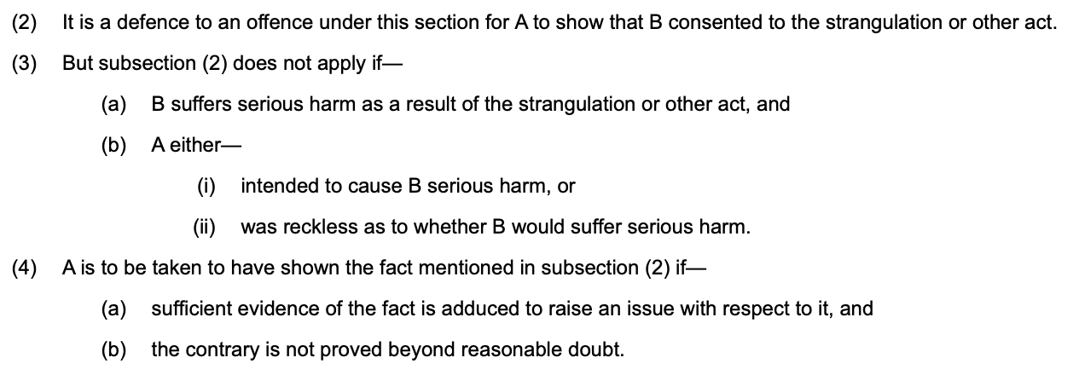
Non-fatal strangulation or suffocation
S.75A – defence
Notes:
(6) In this section “serious harm” means—
(a) grievous bodily harm, within the meaning of section 18 of the Offences Against the Person Act 1861,
(b) wounding, within the meaning of that section, or
(c) actual bodily harm, within the meaning of section 47 of that Act.

Slide 15
Non-fatal strangulation or suffocation
Sentence

Slide 16
Non-fatal strangulation or suffocation
Appropriate charge
s.39 CJA 1988 – common assault or battery
s.47 OAPA 1861 – assault occasioning actual bodily harm
s.21 OAPA 1861 – attempting to choke, suffocate or strangle any other person in order to commit any indictable offence
s.18 OAPA 1861 – wounding with intent to do GBH
s.20 OAPA 1861 – inflicting bodily injury, with or without a weapon
Pleas

Slide 17
Breastfeeding voyeurism
Created by s.48 of the Police, Crime and Sentencing Courts Act 2022: amends s.67A of the Sexual Offences Act 2003 (voyeurism: additional offences)

Slide 18
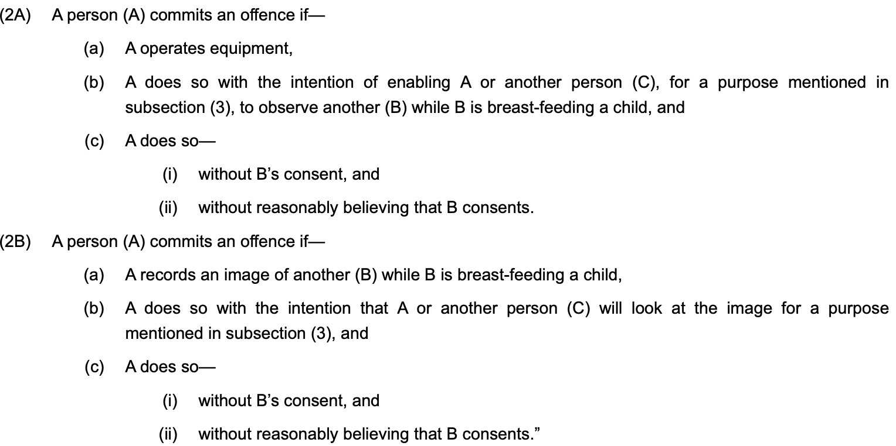
Breastfeeding voyeurism

Slide 19
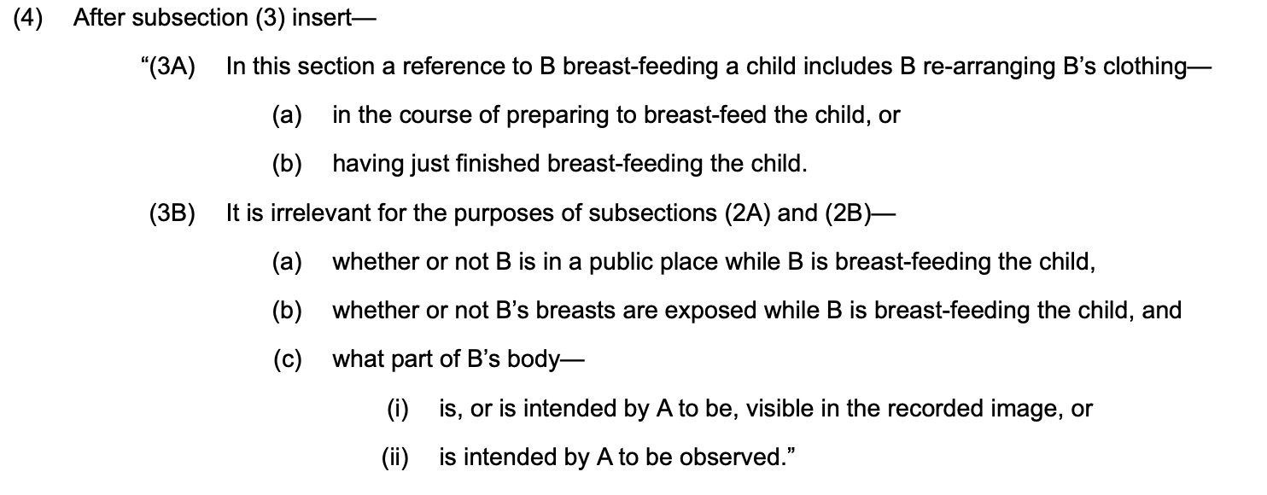
Breastfeeding voyeurism

Slide 20
Breastfeeding voyeurism
Sentence – s.67A (4) Sexual Offences Act 2003
Notes:
The new offences would automatically be added to the list of sexual offences for which (i) victim anonymity is automatic (Sexual Offences (Amendment) Act 1992 and, (ii) where the convicting Court finds the purpose was for “sexual gratification” of the offender, the offender will be subject to the Sex Offender Notification regime.

Slide 21
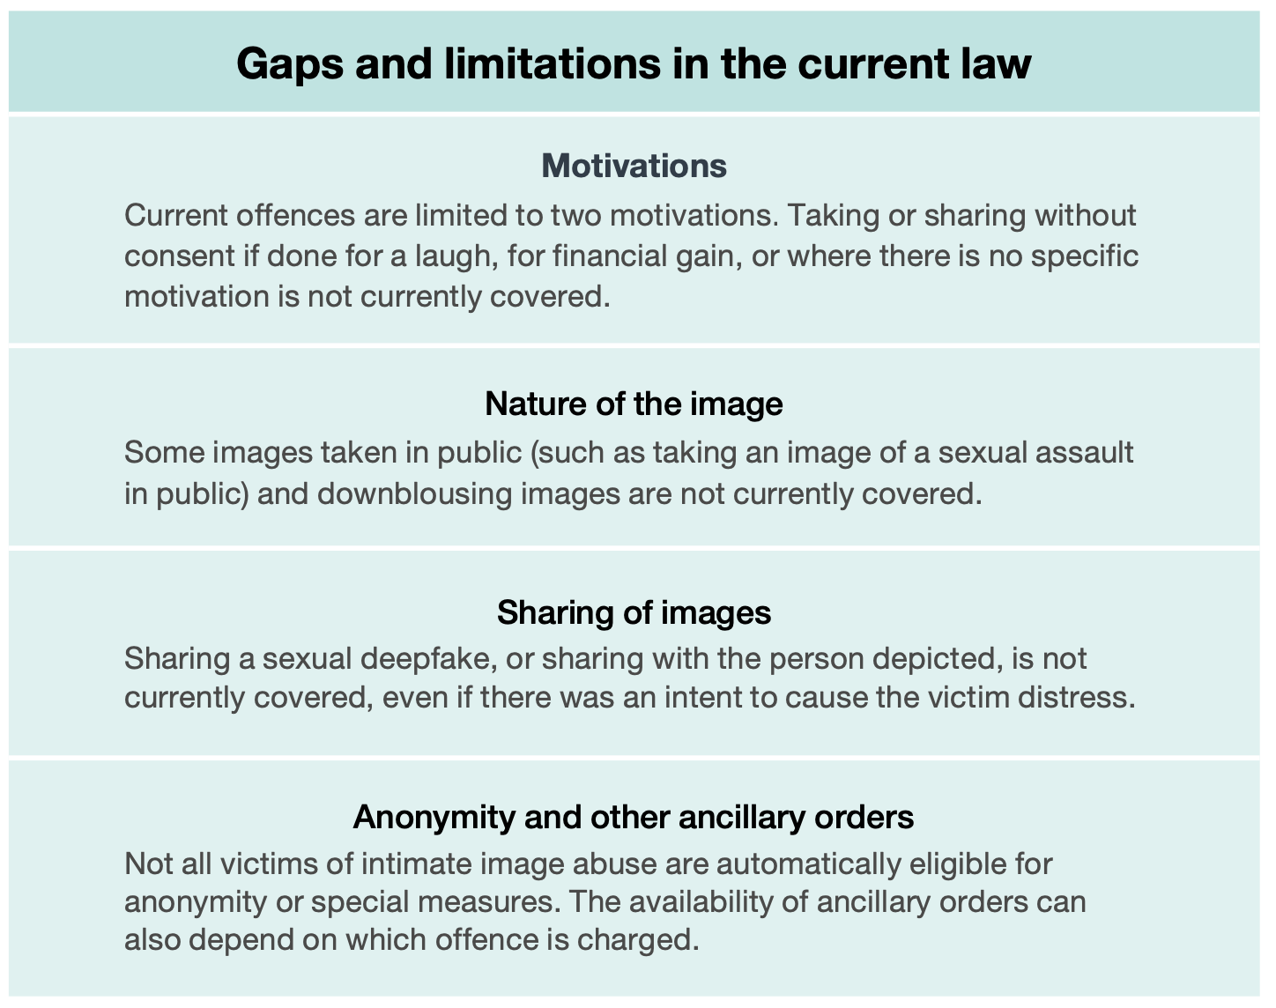
Breastfeeding voyeurism
Law Commission Report
Taking, making and sharing
intimate images without
consent
7 July 2022

Slide 22
Further offences - Police, Crime, Sentencing and Courts Act 2022
s.63: Trespass with intent to search for or pursue hares
Summary only, maximum sentence 6 months’ imprisonment, a fine, or both.
s.64: Being equipped for searching for or pursuing hares with dogs
Summary only, maximum sentence 6 months’ imprisonment, a fine, or both.
s.78 Intentionally or recklessly causing public nuisance
Either way, on summary conviction maximum sentence 12 months’ imprisonment, a fine, or both. On conviction on indictment, 10 years’ imprisonment, a fine, or both.
s.83: Offence relating to residing on land without consent in or with a vehicle
Summary only, maximum sentence 3 months’ imprisonment, a fine, or both.
s.199: Offence of recording or transmission in relation to remote proceedings
Summary only, maximum sentence is a fine.

