Slide 1
Enforcement of Child Arrangement Orders: case law and procedure
Nathalie Bull

Slide 2
Today’s Agenda
Research
Enforceable orders
Enforcement procedure
Range of enforcement orders
Questions

Slide 3
Nuffield Foundation report
‘Enforcing contact orders: problem-solving or punishment?’
1,400 (10%) contact cases return to court seeking enforcement each year.
Case types:
Troubled or conflicted parents (55%);
Risk cases (31%);
Refusal by older children (aged 10+) (10%);
Implacably hostile (4%).
Notes:
The Nuffield Foundation published a report in December 2013 after researching how the family courts respond to applications for enforcement of a contact order following alleged non-compliance
Relatively few contact cases return to court seeking enforcement – about 1,400 each year = 10% of cases
The numbers of implacably hostile cases are very small, only 4% of the enforcement cases
Most enforcement cases are about troubled or conflicted sets of parents, significant safety issues and children making decisions to limit contact

Slide 4
Research findings – approach of the court
A ‘coparenting support approach’ for conflict cases
A ‘protective approach’ for risk cases
A ‘punitive approach’ for implacable hostility.
Notes:
The approach of the court appeared broadly determined by the case type. A 'coparenting support' approach was mostly used with conflict cases as a means to set a clearer framework and help parents communicate, or by setting a new contact timetable, or by efforts to address the conflict and support cooperative co-parenting.
A 'protective approach' was used mainly with risk cases involving safety concerns which were handled by a protective approach based on risk assessment and management.
cases where older children had taken a decision to limit contact, were approached by eliciting and typically responding to children’s wishes and feelings.
Where the court identified that the resident parent was unreasonably and systematically blocking contact, namely implacably hostile, then usually it responded with punitive sanctions.

Slide 5
“There is a need to switch policy attention from the very small number of implacable hostility cases to the broader spectrum of high conflict and chronic litigation cases involved in enforcement… Some of the most difficult cases in the sample, including some of the ‘implacably hostile’ cases and some of the non-meritorious chronic litigants involved parents with mental health difficulties and personality disorders. In these circumstances a therapeutic approach may well be more productive than a purely punitive approach. ”
Nuffield Foundation report, December 2013
Notes:
The report identified a need to switch policy attention from the very small number of implacable hostility cases to the broader spectrum of high conflict and chronic litigation cases involved in enforcement.
In cases involving parents with mental health difficulties and personality disorders, a therapeutic approach may well be more productive than a purely punitive approach.
The report stated that the government’s proposal for an enforcement-specific contact activity could be extremely useful. Since that report, the wording of the activity direction under s.11A-G was substituted by the Children and Families Act 2014.

Slide 6
Child Arrangement Orders
Child arrangement orders are made under s.8 CA 1989
Orders may be subject to conditions (s.11(7)(b))
Including any conditions which must be complied with and for a specific period (s.11(7)(c)).

Slide 7
Activity direction ss11A-11G CA 89
Activities that would help to establish, maintain or improve the involvement in the life of the child concerned of that party or another party (s.11A(3))
May include programmes, classes, counselling, guidance sessions of a kind that:
(a) may assist a person as regards establishing, maintaining or improving contact with a child;
(b) may, by addressing a person’s violent behaviour, enable or facilitate involvement in a child’s life (s.11A(5)).
Notes:
The activity direction enables the court, where there is dispute about the working of a CAO, to order a party to undertake activities to help them to understand the importance to a child of spending time with the non-resident parent.
activities may include programmes, classes, counselling or guidance sessions, but no individual may be required by an activity direction to undergo medical or psychiatric examination, assessment or treatment.
Applications for activity directions can be made alongside a CAO or a variation of such an order.
The Court must obtain and consider info about the individual and the likely effect of the direction on them before making the order.

Slide 8
Activity direction ss11A-11G CA 89
The child’s welfare is the court’s paramount consideration in deciding whether to make such direction (s.11A(9)).
Financial assistance may be available, subject to meeting the requirements (s.11F).
The Court may ask Cafcass to monitor compliance and report to the court on any failure to comply (s.11G(2)).
Notes:
Some financial assistance is available subject to meeting the requirements of s.11F.
Monitoring of the direction is provided for by Cafcass.
In my view activity directions are under-used, save for SPIPs (separated parenting information programme). Activity directions could potentially address the heart of the issues at the outset and avoid the need for later enforcement proceedings and should be used more frequently.

Slide 9
Warning Notices
Cannot enforce without a warning notice (s.11K CA 89).
When making or varying a CAO, the Court must attach a notice warning of the consequences of failing to comply with the CAO (s.11I).
Covers a wider range of individuals.
Can apply for a warning notice to be attached (FPR r12.33) using Form C78. The application must be without notice and the court may deal with the application without a hearing.
Notes:
The court may not make an enforcement order unless the person concerned has received a 'warning notice' or has been otherwise informed of its terms: s 11K.
If the court makes or varies any CAO the court must attach a 'warning of the consequences of failing to comply with the order’.
Warning notices can be addressed to a much wider range of individuals than was the case previously, because applications for enforcement orders and financial compensation orders can be made not only by the person in whose favour the order is made, but also by the person with whom the child lives, or by the child, or any other person subject to a s 11(7) condition or activity condition.
A party may apply for a warning notice to be attached. The procedure is set out at FPR r 12.33. The Rule states the application MUST be made w/o notice.
However, note the Family Court Practice guidance (ON NEXT SLIDE)

Slide 10
‘The without notice order has potential quasi-criminal consequences for the respondent, but does not give him a right to apply to set it aside. In these circumstances, it is respectfully submitted that the safer course would be for the judge to direct a hearing inviting the applicant to file a brief statement setting out the provisions of the order to which he wishes the warning notice to be attached and explaining why he is asking for a warning notice.’
Family Court Practice 2020 2.217[1]
Notes:
As there are quasi-criminal consequences for the respondent the safer course would be for the judge to direct a hearing inviting the applicant to file a brief statement setting out the provisions of the order to which he wishes the warning notice to be attached and explaining why he is asking for a warning notice.’

Slide 11
Out of Jurisdiction
Certain orders, including ‘custody orders’ made within one part of the UK are recognised in all other parts of the UK but must be registered to be enforceable (s.25 FLA 1986).
Orders made in any country which is a party to the Hague or European Conventions are recognised and then enforceable in any other Convention country.
Non-convention countries may refuse to make inconsistent orders, or may refuse to hear the case and refer it back to this jurisdiction.
Notes:
CAOs made within one part of the UK may be recognised in all other parts of the UK as if they had been made in that part. If recognised, an order may be registered and is then enforceable in all other parts of the UK. Importantly, registration is a prerequisite for enforcement.
Orders made in any country which is a party to Hague and European Conventions are recognised and then enforceable in any other Convention country.
In countries other than ‘Convention countries’, the existence of an order made in England and Wales may incline a court in that country to refuse to make inconsistent orders. It may refuse to hear the case, and refer it back to England or Wales; in effect recognising the effect and validity of the order, and enforcing its provisions.

Slide 12
Who can apply to enforce?
S.11J(5) CA 89 only on an application by:
(a) a person with whom the child concerned lives or is to live
(b) a person whose contact with the child concerned is provided for in the CAO
(c) any individual subject to a condition under s.11(7)(b) or an activity condition imposed by the CAO
(d) the child concerned, with leave of the Court.
Notes:
The application for enforcement is made using Form C79.
The court may make an enforcement order only on the application of: (a) a person with whom the child concerned lives or is to live;
(b) a person whose contact with the child concerned is provided for in the child arrangements order;
(c) any individual subject to a condition under section 11(7)(b) or an activity condition; or
(d) the child concerned, subject to leave of the court.
The court may grant leave to the child concerned only if it is satisfied that he has sufficient understanding to make the proposed application.

Slide 13
Considerations upon application
FPR PD12B 21.1 - On any application for enforcement of a child arrangements order, the court shall consider:
whether the relevant facts are agreed, or whether it is necessary to conduct a hearing to establish the facts
reasons for any non-compliance
how the wishes and feelings of the child are to be ascertained
whether advice is required from Cafcass on the appropriate way forward
Notes:
On any application for enforcement of a child arrangements order, the court shall consider a number of factors:
Para 21.7 the court shall (in the absence of agreement between the parties about the relevant facts) determine the facts in order to establish the cause of the alleged failure to comply.
Consider the reasons for non compliance
Consider how the wishes and feelings of the child are to be ascertained.
The court has a discretion as to whether to join the child as a party and may ask a Cafcass officer to consider this and report to the court with their opinion pursuant to FPR 2010, r 16.39.

Slide 14
Considerations upon application
assess and manage any risks of making further or other CAOs
whether a SPIP or referral for dispute resolution is appropriate
whether an enforcement order may be appropriate, and
the welfare checklist.

Slide 15
Gatekeepers
List before the previously allocated judge within 20 working days of issue; enforcement cases should be concluded without delay (FPR PD12B 21.2);
If issued 3+ months after the order, safeguarding checks shall be ordered.
Notes:
Gatekeepers shall list any application for enforcement before the previously allocated judge if possible within 20 working days of issue, enforcement cases should be concluded without delay, as stated in FRP PD12B para 21.2.
On any application for enforcement issued more than three months after the original order, safeguarding checks shall be ordered.

Slide 16
Breach of CAO
The Court must be satisfied beyond reasonable doubt that a person has failed to comply (s.11J(2) CA 89).
The Court may not make an EO if satisfied the person had a reasonable excuse (s.11J(3)).
Burden of proof as to ‘reasonable excuse’ lies on the person in breach, on the balance of probabilities (s.11J(4)).
An obligation to ‘make the child available to spend time with’: does not place the primary carer in breach of the order if the child refuses to co-operate (Re L-W (Enforcement and Committal: Contact); CPL v CH-W and Others [2011] 1 FLR 1095, CA).
Notes:
Where the court is satisfied beyond reasonable doubt that a person has failed to comply with a CAO, it may make an Enforcement Order, or a suspended EO, imposing on that person an 'unpaid work requirement’.
Note that unlike most aspects of Family Law, the court needs to be satisfied “beyond reasonable doubt”. The burden of proof is therefore set higher than the normal “balance of probabilities” hurdle.
However, the court may not make an Enforcement Order if satisfied that the person in breach had a 'reasonable excuse' for breaching the order:
The burden of proving a reasonable excuse is on the person in breach and the standard of proof is the balance of probabilities:
Reasonable excuse case: Re L-W concerns enforcement of CAOs when the child does not wish to go:
Where the parent's obligation is to 'allow' contact or to 'make the child available' for contact, which means to ‘put at one’s disposal, or within one’s reach’, there is no more of an obligation than that. The Court of Appeal held it does not create a legally enforceable obligation on the person to take such steps in the exercise of their parental discipline, guidance and encouragement as were reasonable in all the circumstances to ensure that contact took place. That wording does not place a parent in breach of the order if the child refuses to co-operate. The defence of ‘impossibility of performance’ was accepted on appeal.

Slide 17
Range of Powers
FPR PD12B 21.6
(a) referral of the parents to a SPIP, or mediation
(b) variation of the child arrangements order (including a more defined order and/or reconsidering the contact provision or the living arrangements of the child)
(c) an enforcement order or suspended enforcement order (unpaid work) (s.11J CA 89)
(d) an order for compensation for financial loss (s.11O CA 89)
(e) committal to prison; or
(f) a fine.
Notes:
The court has a wide range of powers in the event of a breach, including:
referral of the parents to a SPIP, or mediation
variation of the CAO
enforcement order or suspended enforcement
an order for compensation for financial loss
committal to prison
Or a fine.

Slide 18
Variation of CAO
More defined arrangements.
An activity direction (s.11A (2B) CA 89) (*see Activity Direction slide above).
Change of living arrangements, or a suspended live with order.
Notes:
It may resolve issues to simply have a more defined CAO.
As an alternative the court may make an activity direction, ordering a party to undertake activities programmes, classes, counselling, or guidance sessions, to help them to understand the importance to a child of spending time with the other parent – more detail is provided in the previous Activity direction slides.
Or it may be appropriate to seek a change of living arrangements if the primary carer is unreasonably unable to support and encourage a relationship with the non-resident parent.
A suspended change of residence order can often have the desired effect without causing the inevitable distress involved in moving a child.
a separate application for a live with order, alongside the enforcement application should be made if this is sought and the child should be made a party to the proceedings through a rule 16.4 Guardian.

Slide 19
Enforcement Order: Unpaid Work
Factors to consider are set out in s.11L and Sch A1, Pt I CA 89:
The Court must be satisfied that an EO is necessary to secure compliance with a CAO and the likely effect of the EO is proportionate to the seriousness of the breach.
Consider whether unpaid work is available in the local justice area (between 40 and 200 hours).
Obtain and consider information about the person and the likely effect of the EO on them (s.11L(3)).
Consider asking Cafcass to report on the suitability of an EO.
Consider the welfare of the child, although not paramount.
Notes:
The Court may order the non-compliant party to undertake unpaid work if that is necessary to secure compliance, and if the effect on the non-compliant party is proportionate to the seriousness of the breach.
The court must consider whether unpaid work is available in the locality. 40-200 hours can be ordered.
the court must obtain and consider information about the person and the likely effect of the enforcement order on him, including:
any conflict with the person's religious beliefs and any interference with the times they normally work or study.
It is good practice to ask Cafcass to report on the suitability of this order.
Section 11L(7) also requires the court to take into account the welfare of the subject child, but this is not its paramount consideration.

Slide 20
Compliance with the EO
Cafcass is to monitor, or arrange for the monitoring of, a person's compliance with the unpaid work and to report to the court on a failure to comply and on any unsuitability to undertake the unpaid work (s.11M CA 89).
A further warning notice setting out the consequences of breaching the EO should be attached.
The court has power to amend or revoke an EO (Sch A1, Pt II).
Notes:
The court is to ask a Cafcass officer to monitor, or arrange for the monitoring of, a person's compliance with an EO, and to report to the court on any failure to comply and on any unsuitability to undertake the unpaid work
the court must attach a warning notice setting out the consequences of breaching the EO including imposition of a further EO; enhancement of the existing EO and use of existing sanctions for contempt.
The court has power to amend or revoke an EO. If the terms of an EO are breached, the court may amend the original order to make it more onerous, or impose another EO.

Slide 21
Financial compensation orders s.11 O CA 89
The court may require a person who has caused financial loss to another person as a result of breaching a CAO to pay compensation up to the amount of the loss.
The court must consider the welfare of any child concerned and the financial circumstances of the person in breach.
Notes:
The court can order financial compensation up to the amount of the loss. Often the court fee and costs are sought.
Before making a compensation order the court must take into account the welfare of any child concerned, and the financial circumstances of the person in breach.

Slide 22
Committal for Contempt
Penal notice on the order (FPR 37.9) - omission is fatal to a committal application (CH v CT [2018] EWHC 1310 (Fam)).
Application under Part 18 for committal for contempt, pursuant to Part 37 & PD37A FPR.
Set out grounds in full for each alleged act of contempt, supported by an affidavit (FPR 37.10).
Serve the application personally, subject to the Court dispensing this rule (FPR 31.20).
Hearing in open court, robes should be worn.
Criminal standard of proof, imprisonment for up to two years.
Notes:
Where an order is not complied with it is open, where grounds exist, for a parent to apply for committal for contempt, of the person in breach of the order, subject to a correctly worded and correctly placed penal notice on the order and subject to complying with all necessary procedural steps under FPR 37 and PD 37A.
The alleged breaches must be particularised with care so that the respondent knows precisely the allegations and is able to marshal their defence.
The application should be personally served, subject to the Court dispensing with this rule.
it is vital to ensure that the evidential and procedural rules are obeyed, and extra vigilance is required when the respondent is a litigant in person.
It is worth noting that the court may waive any procedural defect in the commencement or conduct if satisfied that no injustice has been caused to the respondent by the defect.
the liberty of someone is at stake, therefore, the criminal standard of proof applies, and the burden of proof is on the applicant.
The contempt must be a deliberate disobedience of a court order.
The dual purpose of committal is to punish for the breach and to ensure future compliance. The Maximum sentence is two years imprisonment.
A committal order can be suspended, usually on the condition of compliance with the order.
As the committal hearing is in open court, don’t forget your robes!

Slide 23
Committal case authorities
CH v CT [2018] EWHC 1310 (Fam) – a suspended committal order was set aside due to serious procedural irregularities.
Re L (A Child) sub nom In the Matter of Gous Oddin [2016] EWCA Civ 173 – CofA provided guidance and a checklist.
Borg v El-Zubaidy [2017] EWFC 58 –1 year custodial sentence for failing to return children to the jurisdiction.
Notes:
In CH v CT - the importance of avoiding serious procedural irregularities was emphasised. In that case, a suspended committal order made against a mother who had failed to comply with a CAO was set aside due to serious procedural irregularities. The requirements of Rule 37.10(3) were not satisfied, the mother had not received an application that identified each alleged act of contempt and an Affidavit had not been filed in support. Furthermore, there was a failure to comply with several requirements of PD 37A, namely: (a) There was no penal notice, (b) M had not been properly served with an application, so did not have time to prepare a defence. (c) There was no notice to make the mother aware of the possibility that criminal legal aid might be available.
In Re L the Court of Appeal provided guidance and a very helpful checklist of matters to be considered prior to a committal hearing.
I will not go through the checklist now, but I would invite you to carefully read through it.
In Borg a father was committed to prison for contempt for 1 year for failing to return his children to the UK from Libya, concealing their whereabouts, failing to make them available for telephone contact and failing to instruct members of his family to comply with court orders.

Slide 24
Committal case authorities
Gibbs v Gibbs [2017] EWHC 1700 (Fam) – 9 months custodial sentence for breach of a PSO.
Re O (Committal: Legal Representation) [2019] EWCA Civ 1721 – entitled to non-means tested legal aid.
Notes:
In Gibbs a mother was committed to prison for 9 months where she had breached a PSO by continuing a campaign of unfounded allegations that the father of the children had physically, sexually and emotionally abused them.
In Re O the Court of Appeal held that respondents to committal proceedings were entitled to be provided with legal representation if they wanted it, and would qualify for non-means-tested legal aid; stating that courts are obliged to ensure that such protection is made available, otherwise any resulting committal order might be procedurally irregular.

Slide 25
Costs
Usual ‘no order as to costs’ rule in children proceedings does not apply.
The Court has a discretion (CPR r44.3).
Right to apply for costs after successfully defending an application.
Notes:
The usual rule that costs should not ordinarily be ordered in children proceedings does not apply ‘with its full rigour’ to the costs of proceedings to enforce.
The court has a discretion under CPR, r 44.3 and there is no presumption against making an order for costs.
Anyone facing an application for a quasi-criminal punishment is entitled to be represented, and if they are successful in defending the application they have a right to apply for costs.

Slide 26
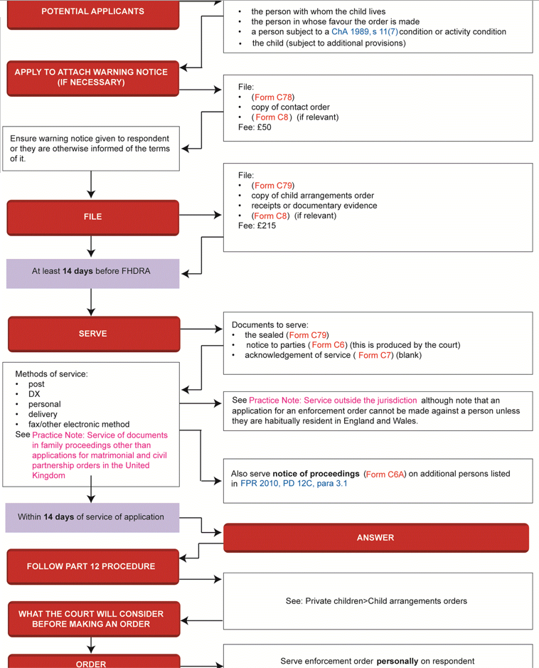
Notes:
I have included a useful Enforcement procedure flow chart which may assist – you will need to zoom in to see the details!

Slide 27
It’s time for Questions & Answers
Questions Welcome
Notes:
Thank you for listening to my talk on enforcement. Please feel free to click on the Question option and I will do my best to reply to the questions either during Liz’s talk or live at the end of the session.

Slide 28
Nathalie Bull, Barrister
T: 0330 332 2633
E: Nathalie.Bull@3pb.co.uk

